Slide 1

SUMMER INSTITUTIONAL TRAINING
ON
Basic of Android Development

Slide 2

START DATE 15TH JUNE,2022
END DATE 1ST JULY, 2022
MODE OF TRAINING ONLINE
TRAINING COMPANY COURSERA
DURATION 2 WEEKS

Slide 3
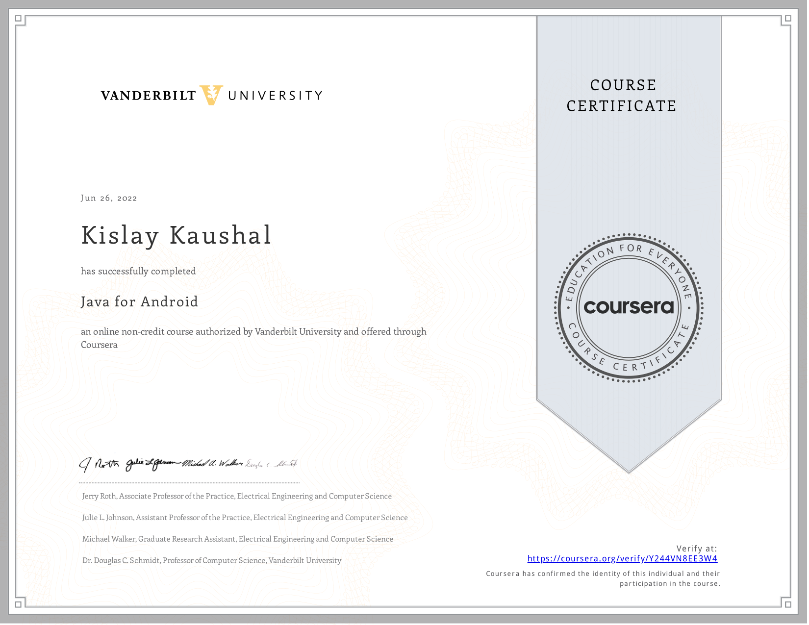
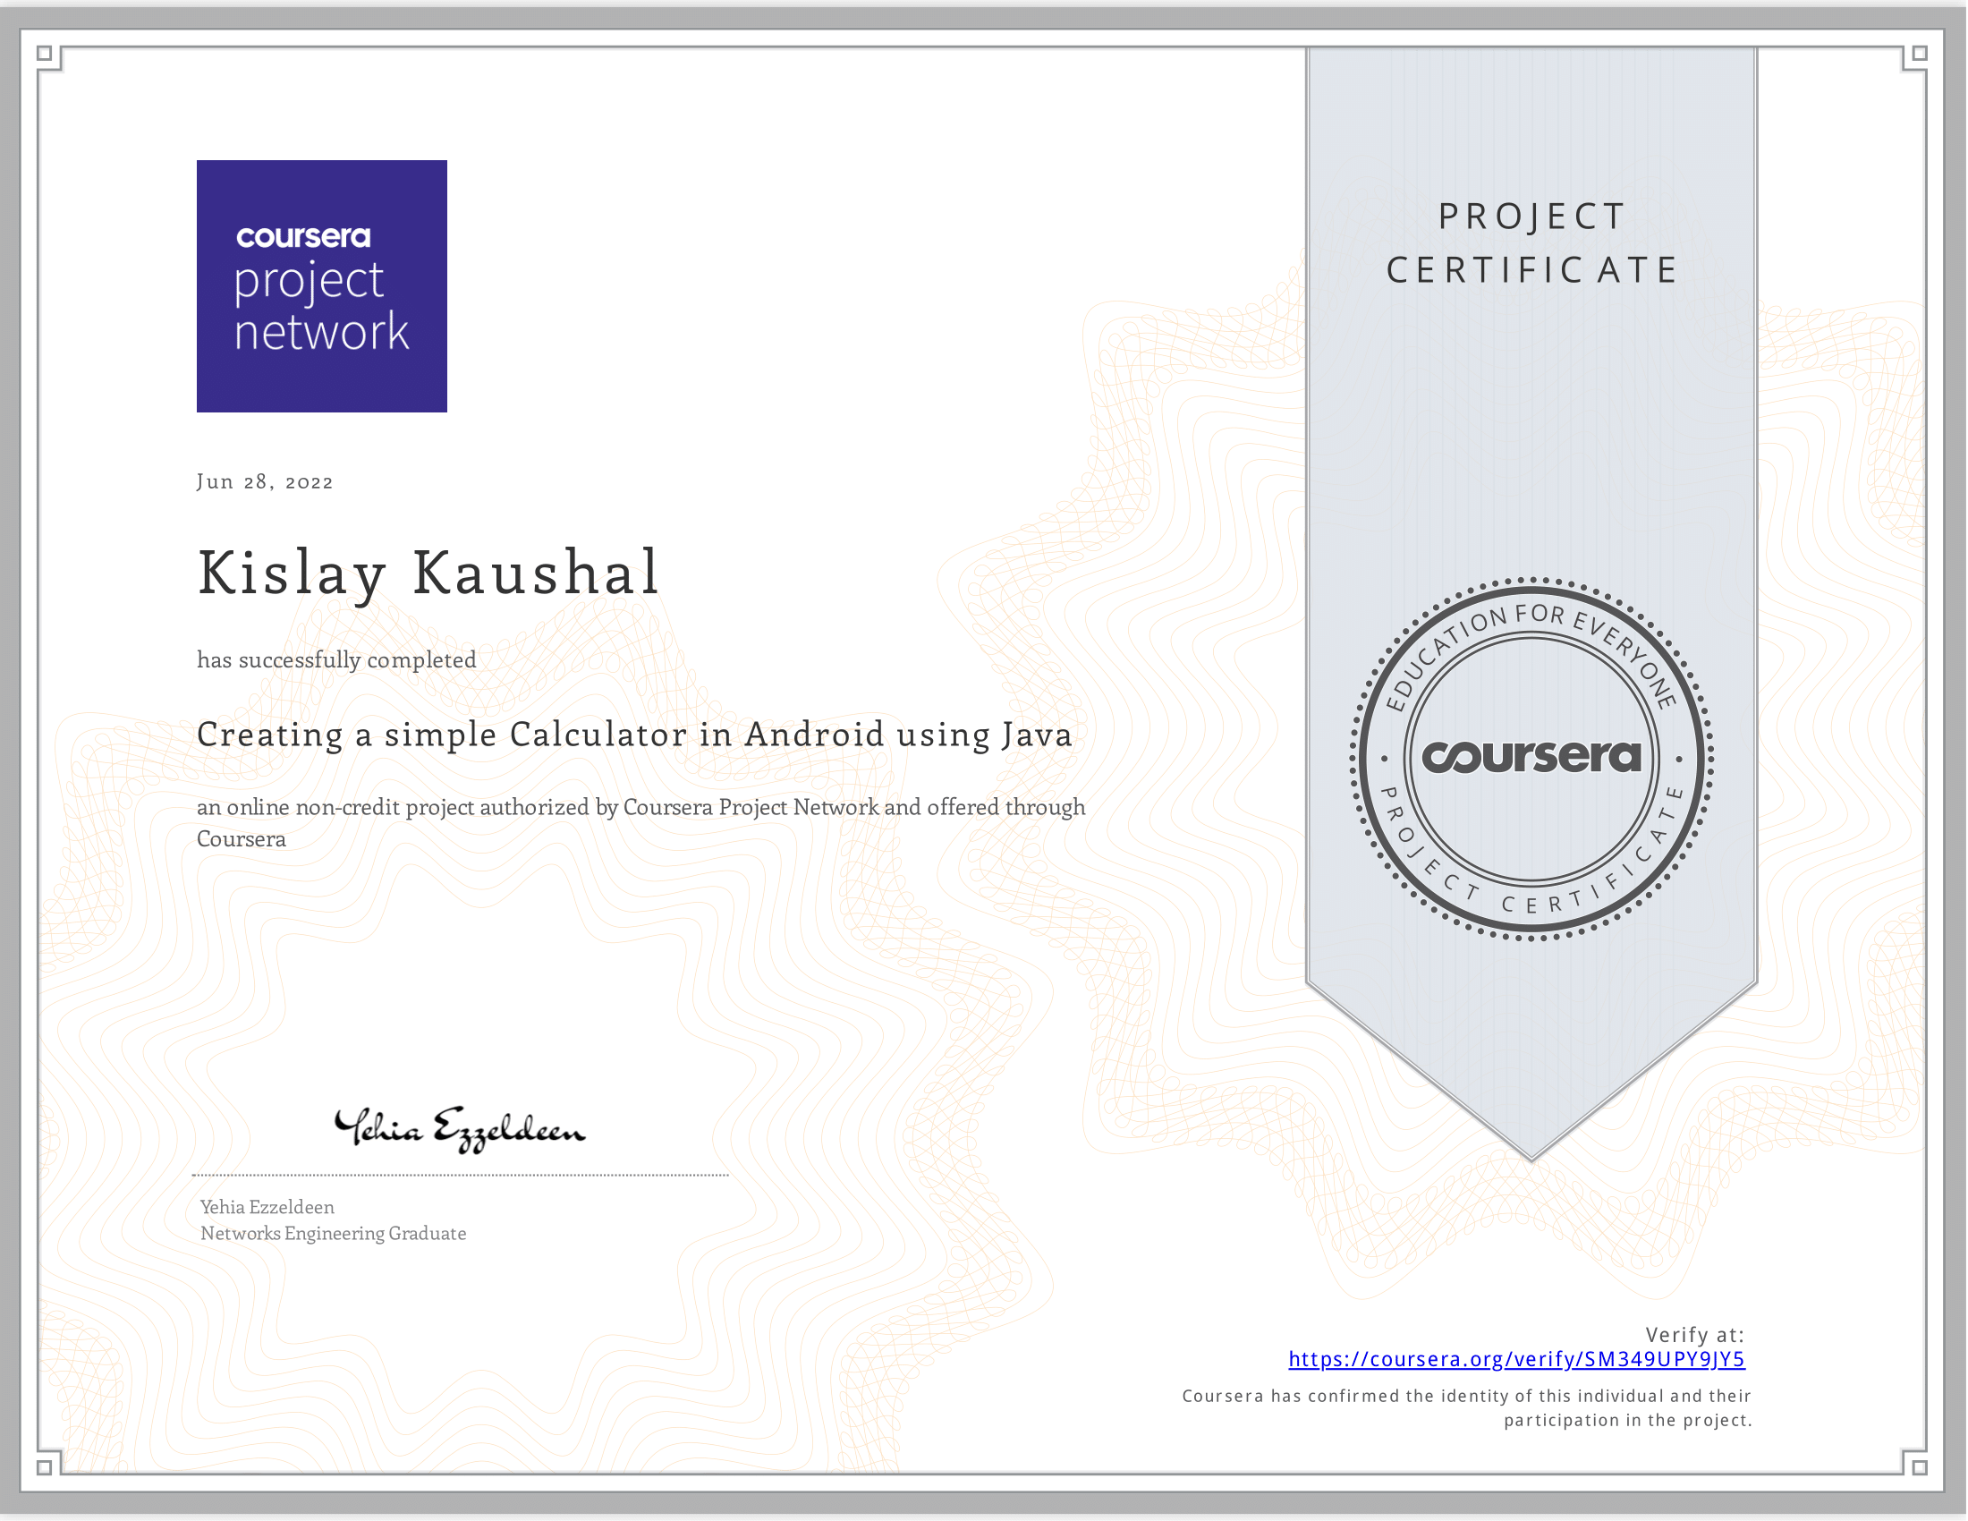
CERTIFICATE OF COMPLETION

Slide 4
CONTENT
INTRRODUCTION
TRAINING WORK UNDERTAKEN
I. Guided project for development of Calculator
II. Mini-Project (To-do list App)
RESULT AND DISCUSSION
I. User Interface
II. Java Source Code
III. XML Source Code
CONCLUSION AND FUTURE SCOPE
I. Conclusion
II. Future Scope

Slide 5

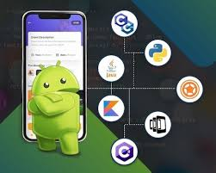
INTRODUCTION
Android is an operating system that is built basically for Mobile phones. It is based on the Linux Kernel and other open-source software and is developed by Google.It is used for touchscreen mobile devices such as smartphones and tablets. But nowadays these are used in Android Auto cars, TV, watches, camera, etc.
Android Fundamental:
Android Programming Languages
I. Java
II. C++
III. KOTLIN
IV. XML

Slide 6
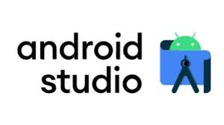
2. Android Studio
Android Studio is the official integrated development environment (IDE) for Android application development. It is based on the IntelliJ IDEA, a Java integrated development environment for software, and incorporates its code editing and developer tools. It is available for download on Windows, macOS and Linux based operating systems or as a subscription-based service in 2020.It is a replacement for the Eclipse Android Development Tools (E-ADT) as the primary IDE for native Android application development.

Slide 7
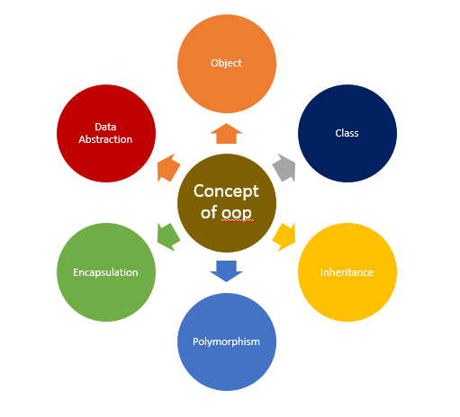
TRAINING WORK UNDERTAKEN
This course teaches us how to program core features and classes from the Java programming language that are used in Android, which is the dominant platform for developing and deploying mobile device apps. And also provide us with hands-on experience with Android Studio through which we developed a Calculator in the end of this course.
Android Programming Language
This course teaches us to program the logic of the App in Java language with teaching us with some conceptual concept which is required for development of application.
Basic of java Language
Conditional statements
Loops(for, while, do-while loops)
Classes and object
ArrayList and HashMap
OOPS concept

Slide 8
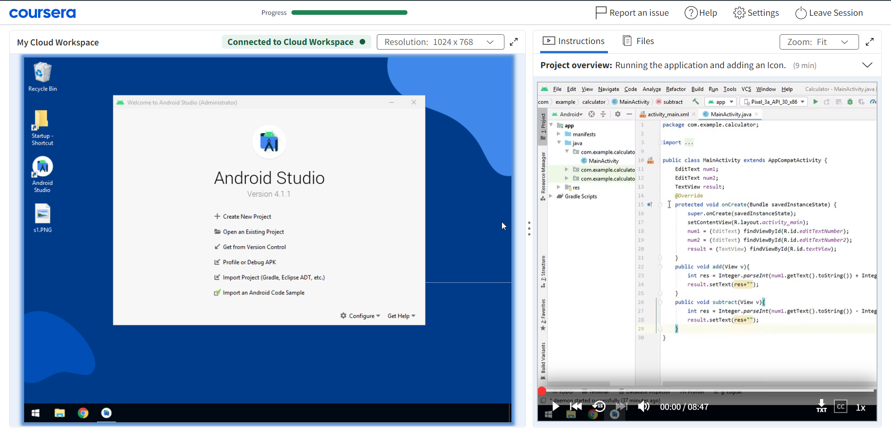
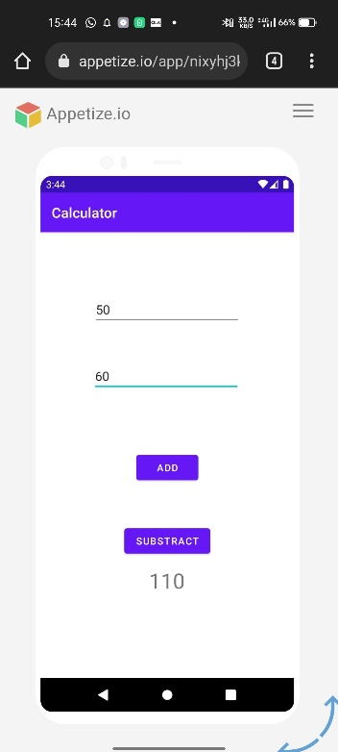
Guided Project of Development of Calculator
In this particular course I learn to develop a calculator and all the development is done on a cloud desktop right in our browser, without downloading android studio or any other resources.

Slide 9

Mini- Project (To-Do list App)
The course teaches us with all the necessary knowledge for the development. So, for the mini-project which is included in this summer training I have decided to develop a To-Do List application. The features of the Application are as followed:-
1. You can add the tasks that are to be done in a descriptive way.
2. You will be able to add as many tasks as you have.
3. Once the task is completed you will be able to strike that task to make it as done task.
4. Once the task is completed, you will be able to remove it by clicking on the task for long and the task will be removed from the list.
All the resources that are used to develop this application are as followed: -
Java language
XML Language
Android Studio

Slide 10
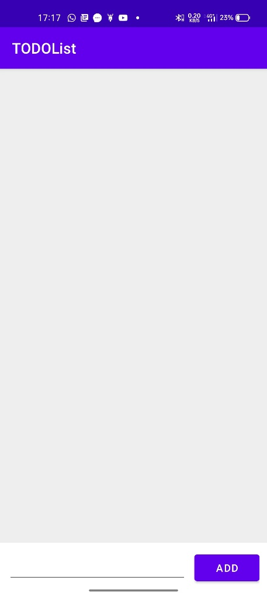
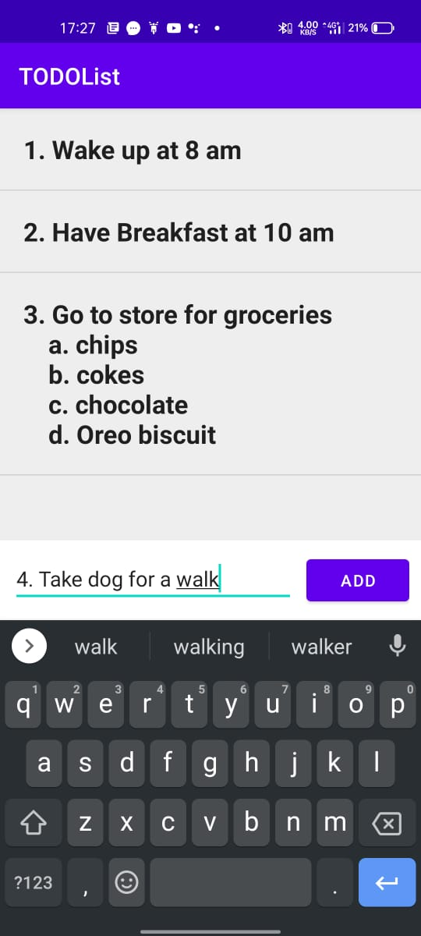
RESULT AND DISCUSSION
The application i.e To-Do list App which is developed as per course content is a very useful for listing your daily items/task that is required to be bought/done. The key feature of the application are:-
* Items can be add on the list by Add button.
* The items can be strike out on the screen.
* The listed items can be removed from the list by long pressing the items.
User Interface

Slide 11
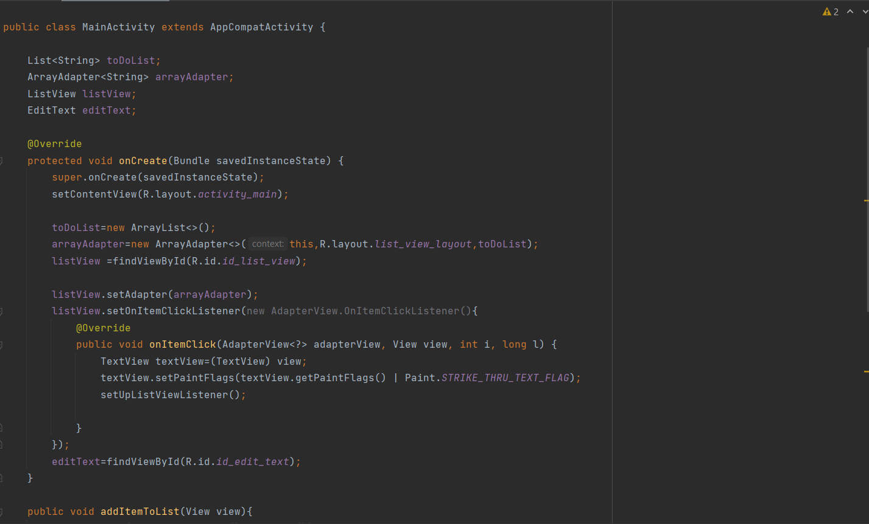
Java Source Code

Slide 12
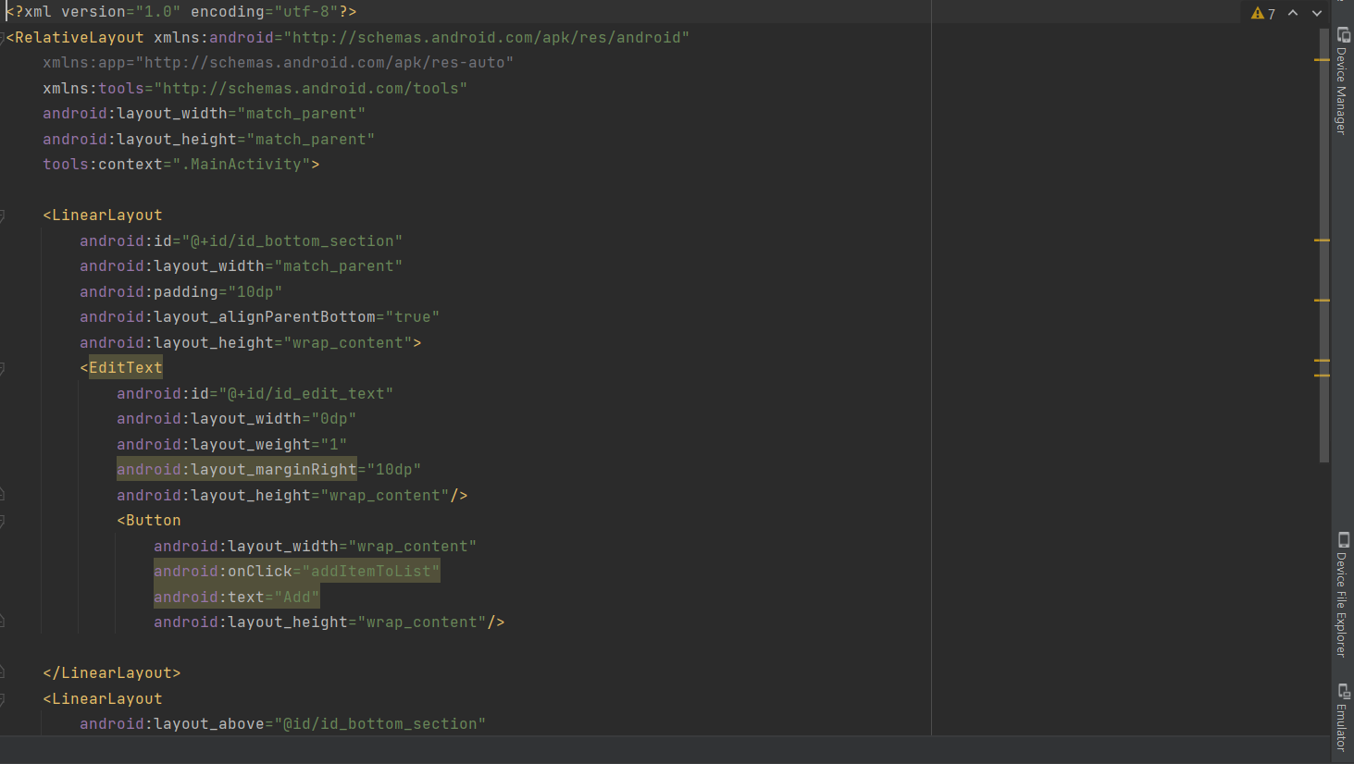
XML Source Code

Slide 13
CONCLUSION AND FUTURE SCOPE
Conclusion
Android Smartphone are in hype in the 21th century. The scope of the android application is increasing day by day. Its development has become an essential part of today’s programming curriculum. The project To-Do List is an android app that incorporates everything from UI design to database. Its utility and efficiency is also very high. More such android app can be developed using similar concepts and tools. The society has a dearth of ideas. These ideas can be most effectively implemented by developing user-friendly android applications. Through this project, I got to learn a lot, including Data structure like ArrayList and HashMap and also I came to know a lot about developing an android application from scratch.
Future scope
India is one of the fastest growing nations in the world as far as IT market is concerned which foretells the propitious scope of Android App Development in India in the coming years. The scope of android app development in IT and other sectors in India can be evaluated from the fact that many of the IT industries generate their revenue majorly through their online android applications.
For Example, e-commerce industries such as Flipkart, Amazon, Snapdeal, eBay, LensKart, Jabong, Myntra etc. sell their products either through website or their android apps. There is enough evidence to prove that Android Development is one of the important parts of our IT industry and somewhere it is playing the part of supporting economy of the country.

Slide 14
THANK YOU!
By:
Name: Kislay Kaushal
UID: 21BCS3449

